Slide 1
Types of houses!
Урок Английского языка
Курс 1
УМК: “Planet of English”
Дерягина Виктория Александровна
ГБПОУ МО СПО «Орехово-Зуевский железнодорожный техникум имени В.И. Бондаренко»

Slide 2
Read and find the equivalent
My home is my castle.
2. There is no place like home.
3. East or West – home is best.
4. Charity begins at home.
5. Every bird likes its own nest.
А. Милосердие начинается дома.
B. В гостях хорошо, а дома лучше.
C. Каждая птица любит своё гнездо.
D. Мой дом – моя
крепость.
E. Нет места лучше, чем дом.

Slide 3
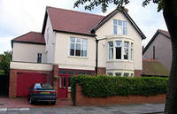
Traditional English House
Many English families live in flats, but a lot of people have got their own houses. The bedrooms, the bathroom and the toilet are upstairs, on the first floor. The sitting room, the dining room, the kitchen and the hall are downstairs.

Slide 4
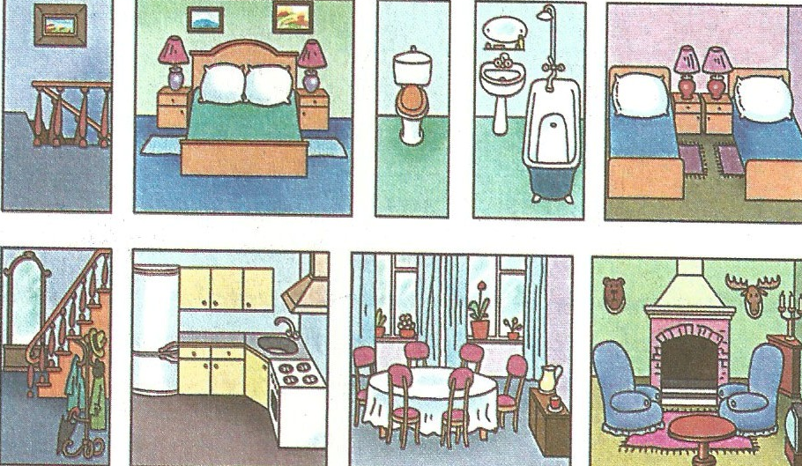
Rooms in the traditional English house
A living room
A bedroom
A dining room
A kitchen
A hall
A bathroom
A toilet

Slide 5
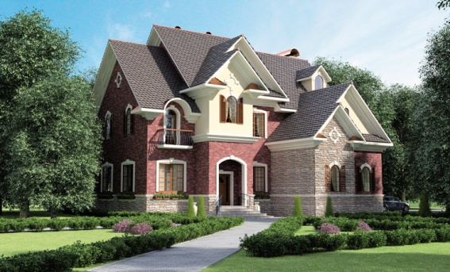
Today people in Britain buy more houses than in the past.
About two thirds of the people in England and the rest of Britain either own, or are in the process of buying, their own home.
Most others live in houses or flats that they rent.
England has many types of homes. In the large cities, people often live in flats. Almost half of London's households are flats.
A big problem in England is the rising cost of houses.

Slide 6
Types of houses in Great Britain
  1. A detached house (a house not joined to another house).
  2. A semi-detached house (two houses joined together).
3. A terraced house (several houses joined together).
4. A block of flat.
5. A cottage.

Slide 7
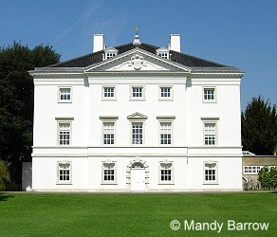
A detached house
(дом, стоящий отдельно)
“Detached” means not connected on any side with any other building. Many British people think that a detached house is the best type of house to live in.

Slide 8
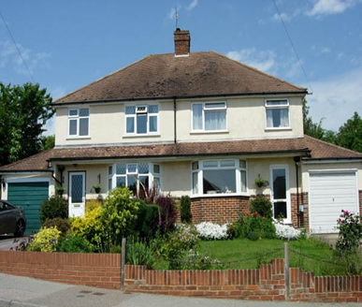
A semi - detached house
(два соединённых вместе дома)
A semi – detached house is a pair of joined houses.
A semi-detached house is the most popular type of home in England (more than 27% of all homes).

Slide 9
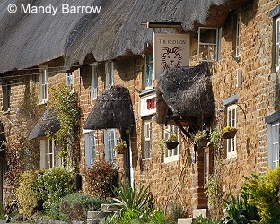
A terraced house
(ряд из несколько домов)
A terraced house is one of a row of similar houses joined together by their side walls.

Slide 10
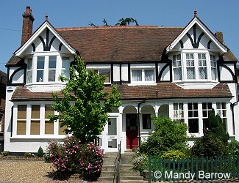
A cottage
The cottage is a lovely small house located outside the city, with a land plot (a garden).

Slide 11
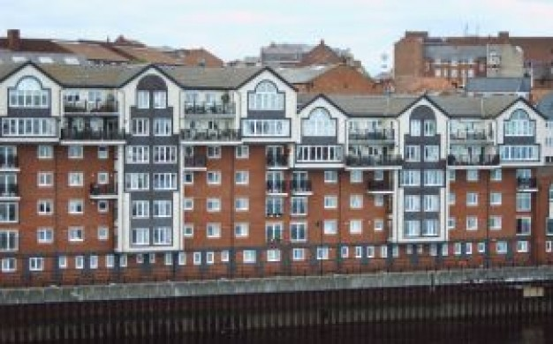
A block of flats
A block of flats is a large building that has a lot of flats where people live.

Slide 12
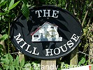
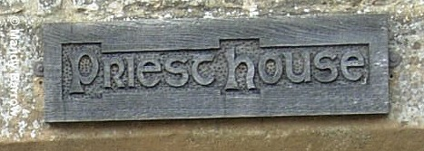

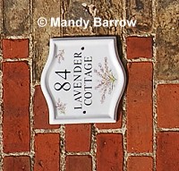
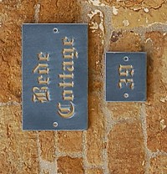
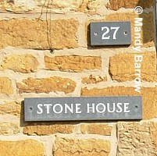
Names of the houses
All houses in Britain have a number. Few of them have a name. For example:
The Mill house Priest house
Poppy Cottage
Stone house Lavender Cottage Bede Cottage

Slide 13
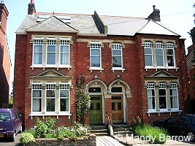
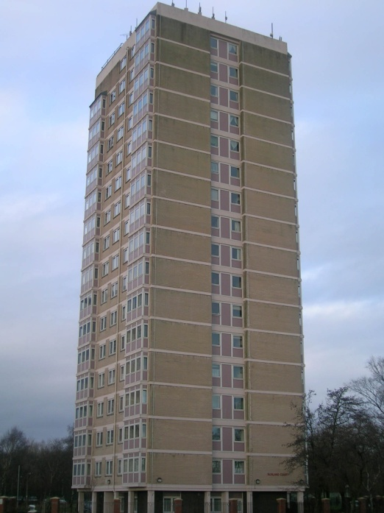
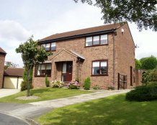
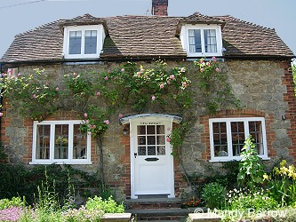
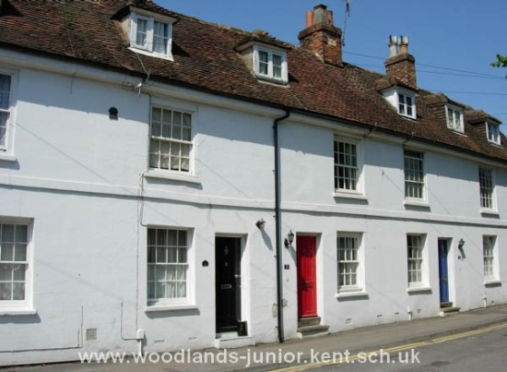
Can you identify the type of the house?

Slide 14
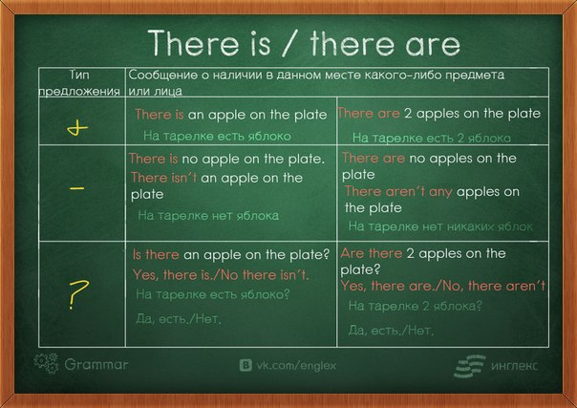

Slide 15
DESK, WARDROBE, BOOK CASE, TABLE, CHAIR, CORNER, OPPOSITE.
Make 5 sentences using the constructions there is/there are and the words below

Slide 16
Describe the house according to the following plan
Type of house (detached, semi-detached, terraced, cottage, block of flats)
Rooms (living room, bedroom, hall, kitchen, attic, bedroom, etc.)
Furniture (bed, table, chair, stove, bedside table, sofa, wardrobe)
Design
Your attitude about it
A piece of your advice

Slide 17
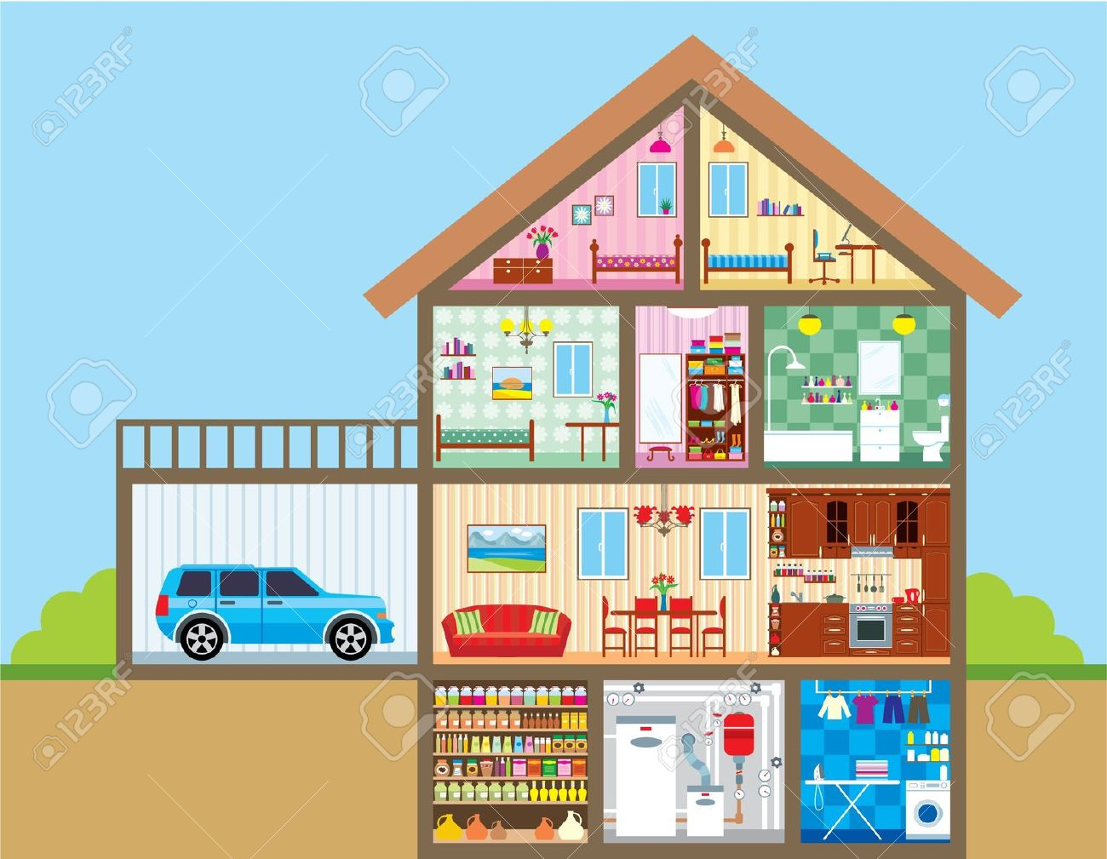

Slide 18
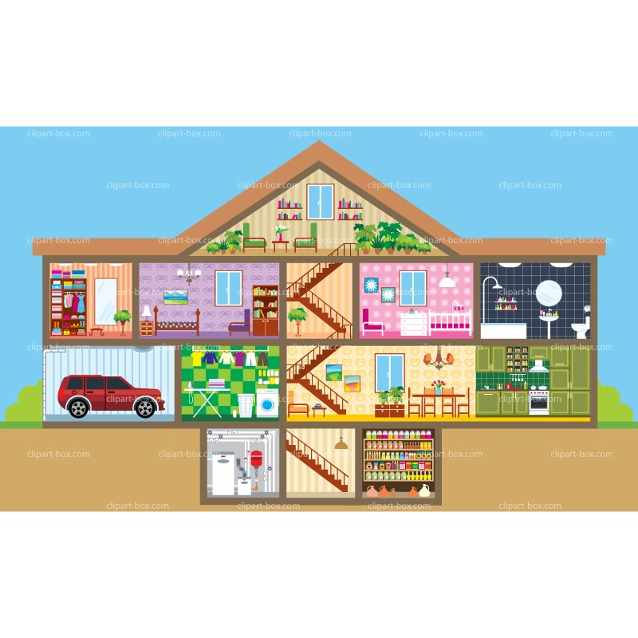

Slide 19
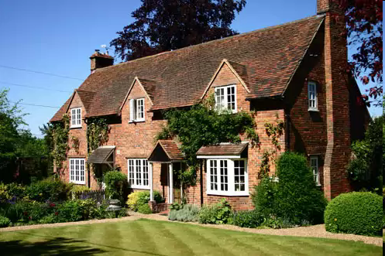

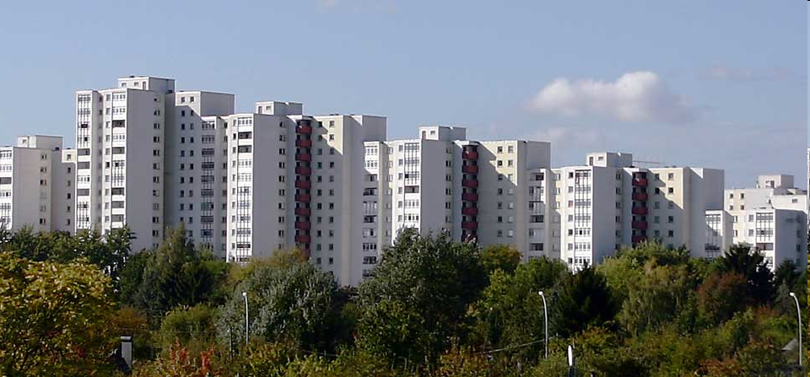
Writing
Write a letter to your British pen friend.
- Ask him questions about the new house
- Give your opinion about it
- Give him a piece of advice

Slide 20
Thank you
for the lesson

